Slide 1
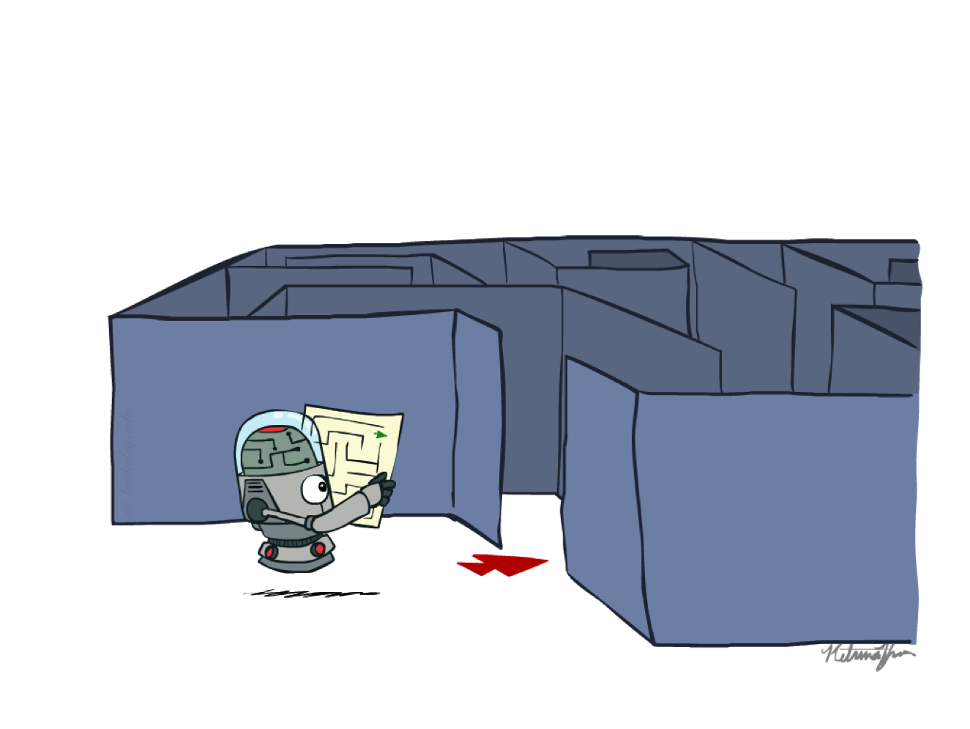
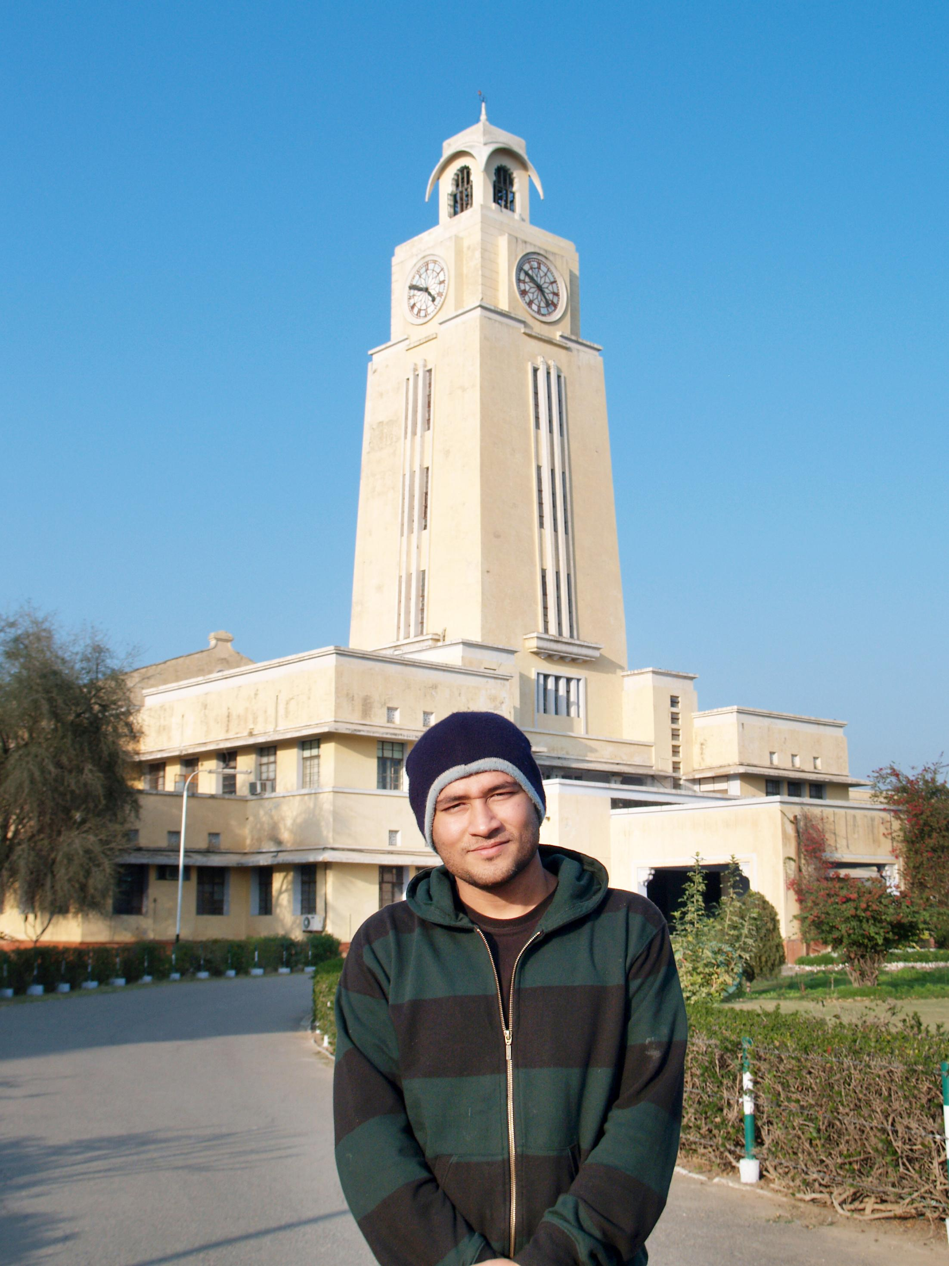


BITS Pilani
Pilani Campus
(some slides adapted from Dan Klein and Pieter Abbeel http://aima.cs.berkeley.edu/)
DSE CL 557 - Artificial and Computational Intelligence
#6. Local Search Algorithms & Optimization Problems
Sunday, October 4, 2020
Dr. Saikishor Jangiti

Slide 2
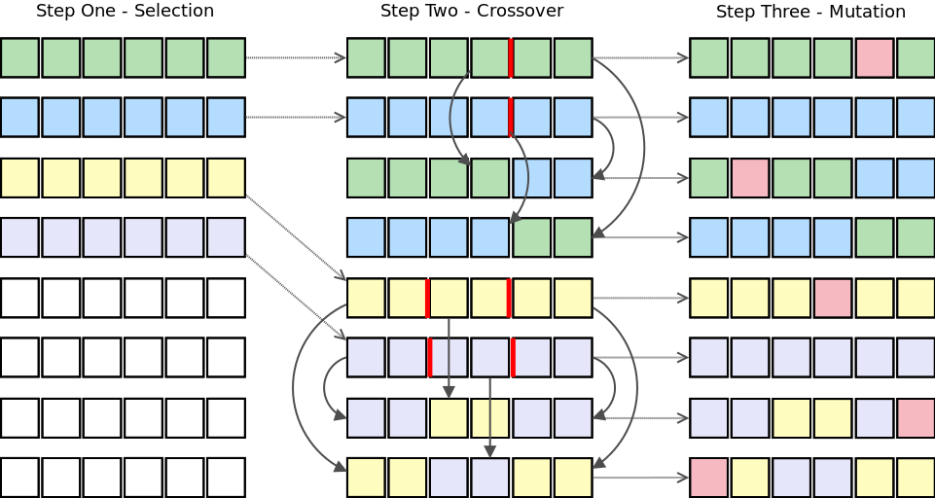
Today
Hill Climbing Search
Simulated Annealing
Local Beam Search
Genetic Algorithm
Reference: Chapter 4.1 & 4.2 from AI: A modern approach (Russell, Norvig)

Slide 3
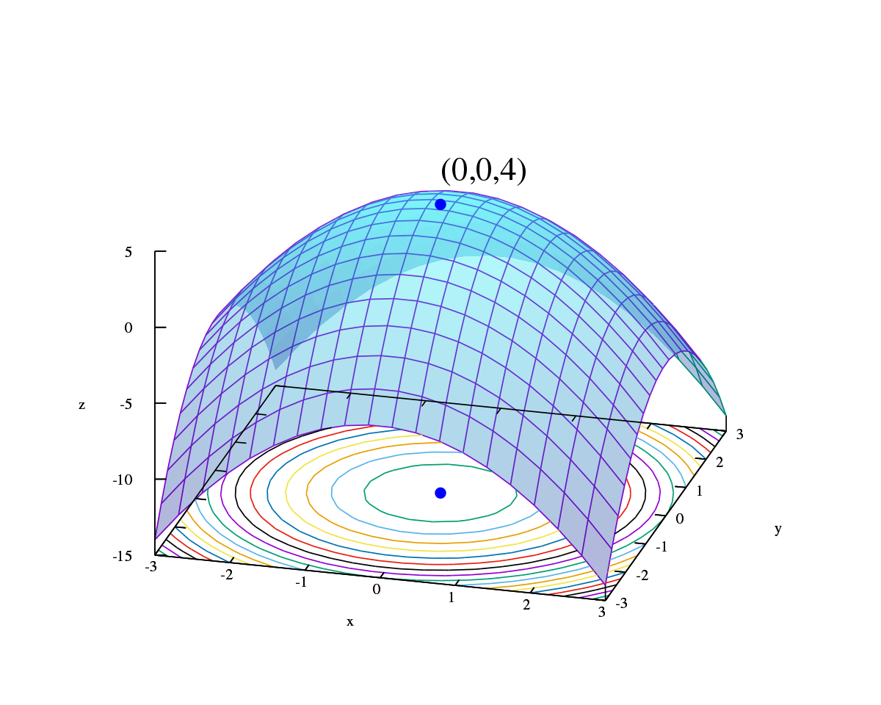
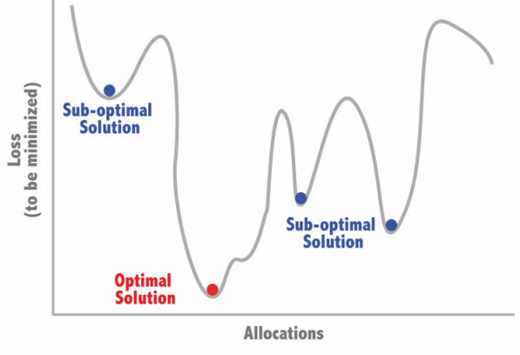
Optimization
Let y = x²⁻4x, at what value of x does y will be maximum.
2 b. 4 c. 6 d. 8

Slide 4
Optimization
“Pure optimization” problems
All states have an objective function
Goal is to find the state with max (or min) objective value
Does not quite fit into path-cost / goal-state formulation
Local search can do quite well on these problems.

Slide 5
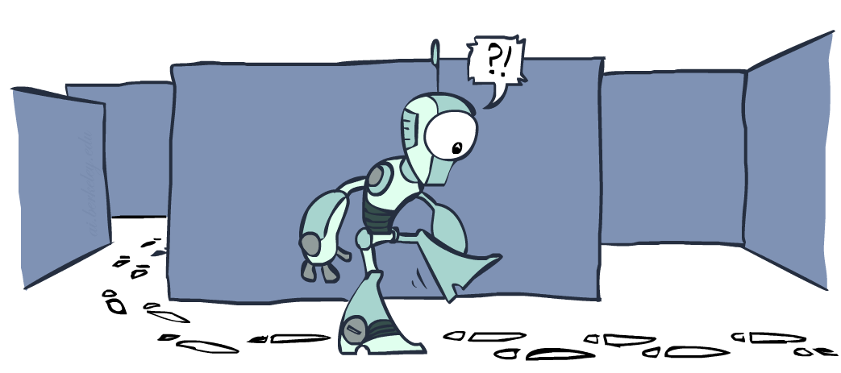
Local Search

Slide 6
Local search and optimization
Till now, the path from start state to goal state is the solution to problem
systematic exploration of search space.
Now, a state is solution to problem
for some problems path is irrelevant.
E.g., 8-queens

Slide 7
Local search
Keep track of single current state
Move only to neighboring states
Ignore paths
Advantages:
–Use very little memory
–Can often find reasonable solutions in large or infinite (continuous) state spaces.

Slide 8
Hill-climbing (Greedy Local Search)
Above is Max version
Min version will reverse inequalities and look for lowest valued successor

Slide 9
Hill-climbing search
“a loop that continuously moves towards increasing value”
–terminates when a peak is reached
–AKA greedy local search
•Value can be either
–Objective function value
–Heuristic function value (minimized)
•Hill climbing does not look ahead of the immediate neighbors
•Can randomly choose among the set of best successors
–if multiple have the best value

Slide 10
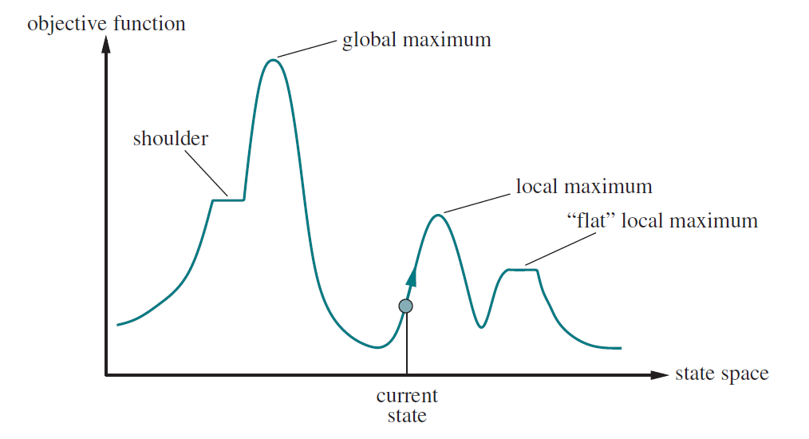
“Landscape” of search
Hill Climbing gets stuck in local minima
Local maxima: a local maximum, as opposed to a global maximum, is a peak that is lower than the highest peak in the state space.
Plateaux: a plateau is an area of the state space where the evaluation function is essentially flat. The search will conduct a random walk.
Ridges: a ridge may have steeply sloping sides, so that the search reaches the top of the ridge with ease, but the top may slope only very gently toward a peak. Unless there happen to be operators that move directly along the top of the ridge, the search may oscillate from side to side, making little progress.

Slide 11
Variations of Hill-climbing
Stochastic hill climbing chooses at random from among the uphill moves
First-choice hill climbing implements stochastic hill climbing by generating successors randomly until one is generated that is better than the current state.
This is a good strategy when a state has many (e.g., thousands) of successors.

Slide 12
Variations of Hill-climbing
The hill-climbing algorithms described so far are incomplete
they often fail to find a goal when one exists because they can get stuck on local maxima.
Random-restart hill climbing adopts the well-known adage
"If at first you don't succeed, try, try again.“
It conducts a series of hill-climbing searches from randomly generated initial states, until a goal is found.
It is trivially complete with probability approaching 1, because it will eventually generate a goal state as the initial state.

Slide 13
BITS Pilani
Pilani Campus
(some slides adapted from Dan Klein and Pieter Abbeel http://aima.cs.berkeley.edu/)
Simulated Annealing
Sunday, October 4, 2020
Dr. Saikishor Jangiti

Slide 14
Simulated Annealing
Simulated Annealing = physics inspired twist on random walk
•Basic ideas:
–like hill-climbing identify the quality of the local improvements
–instead of picking the best move, pick one randomly
–say the change in objective function is d
– if d is positive, then move to that state
– otherwise, move to this state with probability proportional to d
• thus:
– worse moves (very large negative d) are executed less often
– however, there is always a chance of escaping from local maxima
– over time, make it less likely to accept locally bad moves
– (Can also make the size of the move random as well,
i.e., allow “large” steps in state space)

Slide 15
Simulated Annealing

Slide 16
BITS Pilani
Pilani Campus
(some slides adapted from Dan Klein and Pieter Abbeel http://aima.cs.berkeley.edu/)
Local beam search
Sunday, October 4, 2020
Dr. Saikishor Jangiti

Slide 17
Motivation
Search Algorithms like BFS, DFS and A* etc. are infeasible on large search spaces.
Beam Search was developed in an attempt to achieve the optimal(or sub-optimal) solution without consuming too much memory.
It is used in many machine translation systems.
Notes:
1point contd. : because their memory consumption increases exponentially.

Slide 18
Where to use Beam Search?
In many problems path is irrelevant, we are only interested in a solution (e.g. 8-queens problem)
This class of problems includes
Integrated-circuit design
Factory-floor layout
Job scheduling
Network optimization
Machine translation

Slide 19
Beam Search
Is heuristic approach where only the most promising ß nodes (instead of all nodes) at each step of the search are retained for further branching.
ß is called Beam Width.
Beam search is an optimization of best-first search that reduces its memory requirements.
Notes:
Diff btwn local beam search and beam search

Slide 20
Beam Search Algorithm
OPEN = {initial state}
while OPEN is not empty do
1. Remove the best node from OPEN, call it n.
2. If n is the goal state, backtrace path to n (through recorded parents) and return path.
3. Create n's successors.
4. Evaluate each successor, add it to OPEN, and record its parent.
5. If |OPEN| > ß , take the best ß nodes (according to heuristic) and remove the others from the OPEN.
done
Notes:
The concept of closed list?

Slide 21
Beam Search vs. A*
In 48-tiles Puzzle, A* may run out of memory since the space requirements can go up to order of 10⁶¹.
Experiment conducted shows that beam search with a beam width of 10,000 solves about 80% of random problem instances of the 48-Puzzle (7x7 tile puzzle).

Slide 22
Completeness of Beam Search
In general, the Beam Search Algorithm is not complete.
Even given unlimited time and memory, it is possible for the Algorithm to miss the goal node when there is a path from the start node to the goal node (example in next slide).
A more accurate heuristic function and a larger beam width can improve Beam Search's chances of finding the goal.

Slide 23
Example with ß=2
Steps:
1. OPEN= {A}
H=1 H= 3 2. OPEN= {B,C} 3. OPEN={D,E}
4. OPEN={E}
5. OPEN={}
H=2 H=2 H=3 H=0
Clearly, open set becomes empty without finding goal node .
With ß = 3, the algorithm succeeds to find goal node.
A
B
C
D
E
F
G

Slide 24
Optimality
Just as the Algorithm is not complete, it is also not guaranteed to be optimal.
This can happen because the beam width and an inaccurate heuristic function may cause the algorithm to miss expanding the shortest path.
A more precise heuristic function and a larger beam width can make Beam Search more likely to find the optimal path to the goal.

Slide 25
Notes
A beam search is most often used to maintain tractability in large systems with insufficient amount of memory to store the entire search tree.
Used widely in machine translation systems.
Beam Search is neither complete nor optimal.
Despite these disadvantages, beam search has found success in the practical areas of speech recognition, vision, planning, and machine learning (Zhang, 1999).

Slide 26
BITS Pilani
Pilani Campus
(some slides adapted from Dan Klein and Pieter Abbeel http://aima.cs.berkeley.edu/)
Genetic Algorithm
Sunday, October 4, 2020
Dr. Saikishor Jangiti

Slide 27
The Next Hour
Evolution
Genetic Algorithm
Some Applications of Genetic Algorithm

Slide 28


Evolution
Evolution
Evolution is the process by which modern organisms have descended from ancient ones
Microevolution
Microevolution is evolution within a single population; (a population is a group of organisms that share the same gene pool). Often this kind of evolution is looked upon as change in gene frequency within a population

Slide 29
Evolution
For evolution to occur
Heredity
Information needs to be passed on from one generation to the next
Genetic Variation
There has to be differences in the characteristics of individuals in order for change to occur
Differential Reproduction
Some individuals need to (get to) reproduce more than others thereby increasing the frequency of their genes in the next generation

Slide 30
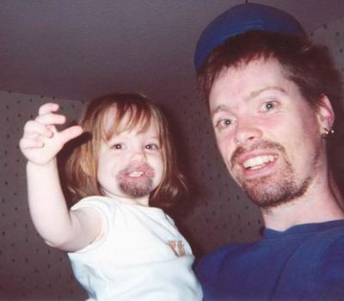
Evolution
Heredity
Heredity is the transfer of characteristics (or traits) from parent to offspring through genes

Slide 31
Evolution
Genetic Variation
Is about variety in the population and hence presence of genetic variation improves chances of coming up with “something new”
The primary mechanisms of achieving genetic variation are:
Mutations
Gene Flow
Sexual Reproduction

Slide 32
Evolution
Mutation
It is a random change in DNA
It can be beneficial, neutral or harmful to the organism
Not all mutations matter to evolution

Slide 33
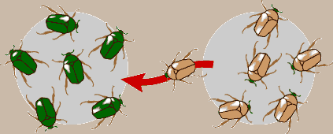
Evolution
Gene Flow
Migration of genes from one population to another
If the migrating genes did not exist previously in the incident population then such a migration adds to the gene pool

Slide 34
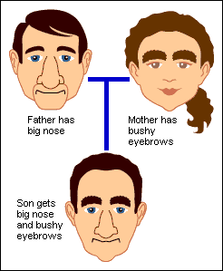
Evolution
Sexual Reproduction
This type of producing young can introduce new gene combinations through genetic shuffling

Slide 35
Evolution
Differential Reproduction
As the genes show up as traits (phenotype) the individuals get affected by what is around; some die young while others live
Those who live compete for mates; only the winners pass on their gene to the next generation
In some sense the fitter (with respect to the current environment) gets to leave more of his/her genes in the next population; often the term fitness is used to describe the relative ability of individuals to pass on their genes

Slide 36




Evolution
Overview
Variation
Differential Reproduction
Heredity

Slide 37
From Organisms to Abstract Beings
The fight to survive (selection operation)
110011
101010
110010
000010
010010
111001
000000

Slide 38
From Organisms to Abstract Beings
The Survivors and Mating
Offsprings
111
010
110010
101010
110
00
0
111001
111
0
010
010010
110011

Slide 39
Genetic Algorithms
Basic Questions
How does one decide who survives
How does one decide how successfully each survivor produces offsprings
How are the offsprings related to the parents
How does one ensure that genetic variation is maintained even though with every generation individuals are supposed to become fitter

Slide 40
Genetic Algorithms
Population of
individuals or alternative
(feasible) solutions
Next generation
of
individuals
Evaluate individuals
on their fitness
Differential Reproduction
Select individuals
based on fitness
for subsequent mating
Arbitrarily change
some characteristic
Genetic Variation
Select individuals
& exchange charac-
teristics to create
new individuals
Heredity
Mating pool of
“fitter”
individuals

Slide 41
Genetic Algorithms
What is an individual?
z
x,y,z
24,2,11
1001,0000,1101
y
x
i
i
h
h
g
g
(a,b)(b,c)(c,d)…(h,i)
a,b,c,d,…i
d
e
d
f
e
f
a
b
c
a
b
c

Slide 42
Genetic Algorithms
Basic Tasks
Generation of initial population
Evaluation
Selection (Reproduction operation)
Exchange characteristics to develop new
individuals (Crossover operation)
Arbitrarily modify characteristics in new
individuals (Mutation operation)

Slide 43
Genetic Algorithms
Reproduction / Selection Operator
The purpose is to bias the mating pool (those who can pass on their traits to the next generation) with fitter individuals
Assign p as the prob. of choosing
an individual for the mating pool
p is proportional to the fitness
Choose an individual with prob. p
and place it in the mating pool
Continue till the mating pool size
is the same as the initial population’s
Choose n individuals randomly
Pick the one with highest fitness
Place n copies of this individual in
the mating pool
Choose n different individuals and
repeat the process till all in the
original population have been chosen

Slide 44
Genetic Algorithms
Crossover operator
1 0 0 1 1 0 1
1 0 0 1 1 1 1
1 1 0 0 1 0 1
1 1 0 0 1 1 1

Slide 45
Genetic Algorithms
Mutation
1 0 0 1 1 0 1
1 0 0 0 1 0 1

Slide 46
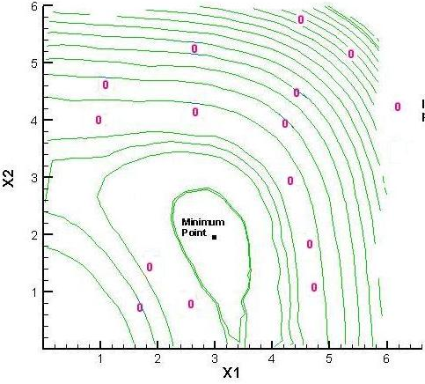
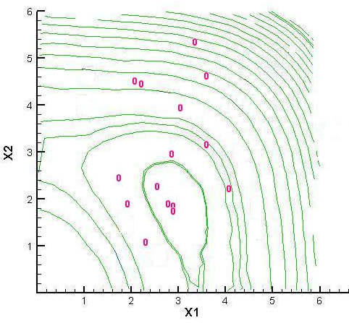
Genetic Algorithms
Results from a small example:
Minimize
Initial Population
Generation 10

Slide 47
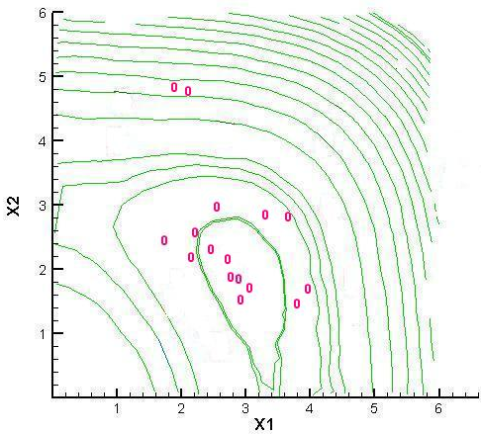

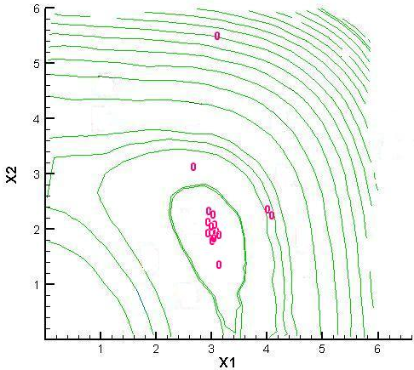
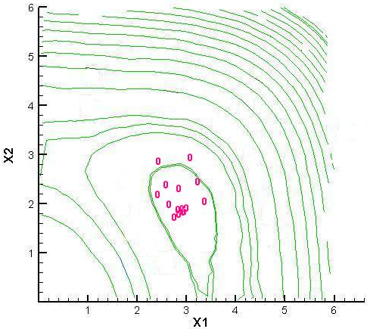
Genetic Algorithms
Generation 20
Generation 30
Generation 40
Generation 50

Slide 48
GA operators: Selection
Main idea: better individuals get higher chance
Chances proportional to fitness
Implementation: roulette wheel technique
Assign to each individual a part of the roulette wheel
Spin the wheel n times to select n individuals
1/6 = 17%
B
A
C
fitness(A) = 3
3/6 = 50%
2/6 = 33%
fitness(B) = 1
fitness(C) = 2

Slide 49
An example after Goldberg ‘89
Simple problem: max x² over {0,1,…,31}
GA approach:
Representation: binary code, e.g. 01101 ↔ 13
Population size: 4
1-point xover, bitwise mutation
Roulette wheel selection
Random initialisation
We show one generational cycle done by hand

Slide 50
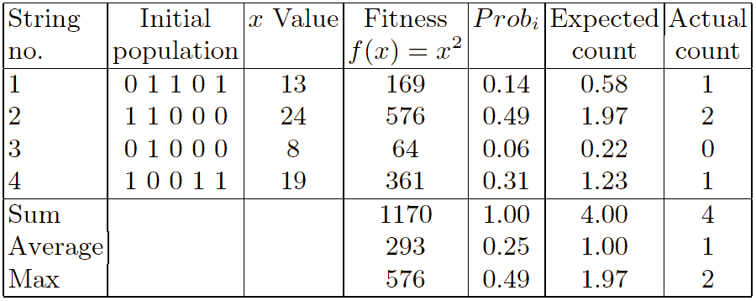
x² example: selection

Slide 51
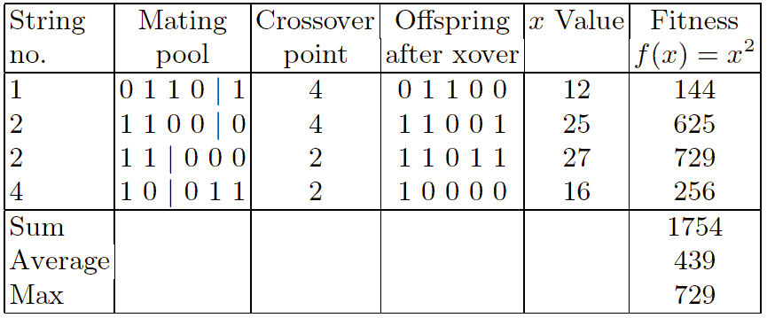
X² example: crossover

Slide 52
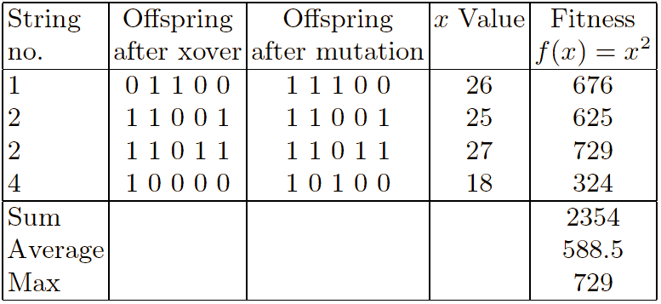
X² example: mutation

Slide 53
The simple GA
Has been subject of many (early) studies
still often used as benchmark for novel GAs
Shows many shortcomings, e.g.
Representation is too restrictive
Mutation & crossovers only applicable for bit-string & integer representations
Selection mechanism sensitive for converging populations with close fitness values
Generational population model (step 5 in SGA repr. cycle) can be improved with explicit survivor selection

Slide 54
Alternative Crossover Operators
Performance with 1 Point Crossover depends on the order that variables occur in the representation
more likely to keep together genes that are near each other
Can never keep together genes from opposite ends of string
This is known as Positional Bias
Can be exploited if we know about the structure of our problem, but this is not usually the case

Slide 55
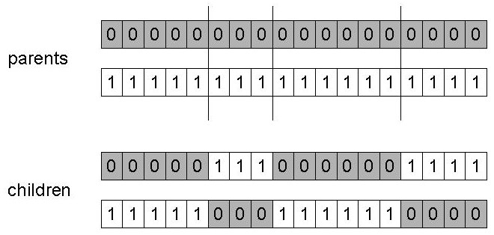
n-point crossover
Choose n random crossover points
Split along those points
Glue parts, alternating between parents
Generalisation of 1 point (still some positional bias)

Slide 56
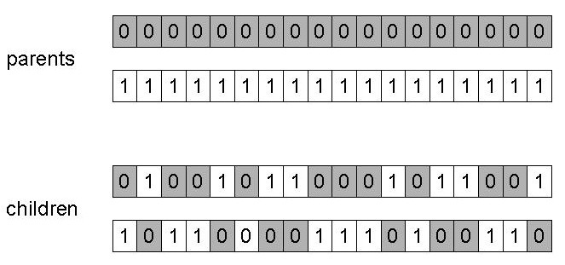
Uniform crossover
Assign 'heads' to one parent, 'tails' to the other
Flip a coin for each gene of the first child
Make an inverse copy of the gene for the second child
Inheritance is independent of position

Slide 57
Crossover OR mutation?
Decade long debate: which one is better / necessary / main-background
Answer (at least, rather wide agreement):
it depends on the problem, but
in general, it is good to have both
both have another role
mutation-only-EA is possible, xover-only-EA would not work

Slide 58
Crossover OR mutation? (cont’d)
Exploration: Discovering promising areas in the search space, i.e. gaining information on the problem
Exploitation: Optimising within a promising area, i.e. using information
There is co-operation AND competition between them
Crossover is explorative, it makes a big jump to an area somewhere “in between” two (parent) areas
Mutation is exploitative, it creates random small diversions, thereby staying near (in the area of ) the parent

Slide 59
Crossover OR mutation? (cont’d)
Only crossover can combine information from two parents
Only mutation can introduce new information (alleles)
Crossover does not change the allele frequencies of the population (thought experiment: 50% 0’s on first bit in the population, ?% after performing n crossovers)
To hit the optimum you often need a ‘lucky’ mutation

Slide 60
Genetic Algorithms
Issues
Representation
Generation of initial population
Evaluation
Reproduction operation
Crossover and Mutation operations and
feasibility issues

Slide 61
Some Applications
Decision making / decision support systems
Engineering component / equipment design
Engineering process optimization
Portfolio optimization
Route optimization; optimal layout; optimal packing
Schedule optimization
Protein structure analysis

Slide 62
Thank you for your Attention
Any more queries

